Slide 1

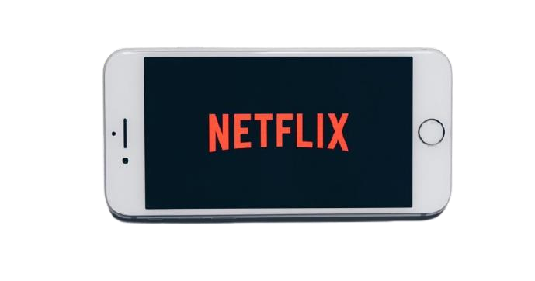
NETFLIX
User Growth
Subhadip Samanta

Slide 2
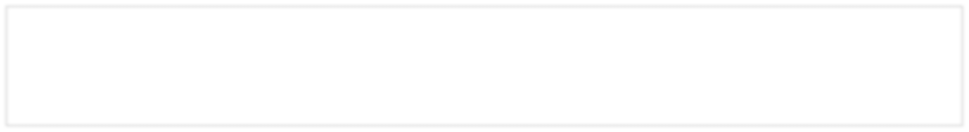




About Netflix
Netflix, Inc. is an American over-the-top content platform and production company headquartered in Los Gatos, California. Netflix was founded in 1997 by Reed Hastings and Marc Randolph. The initial business model included DVD sales and rental by mail. Netflix’s current business is a subscription-based streaming service offering online streaming from a library of films and television series, including those produced in-house. As of October 2020, Netflix had over 195 million paid subscriptions worldwide
Mission: “To entertain the world.”
Vision: “To continue being one of the leading firms of the internet entertainment era.”
Netflix StreamFest launched in India on Dec 5-6 to allow non-subscribers to experience the service for free. The move was aimed at bringing new users to the platform.
Competitors:
Problem Statement
Goal
YoY growth slowed for last 2-3 years due to stiff competition
Increase user acquisition and growth

Slide 3



User Personas
Personas | Abhay, Techie | Mansi, PhD Student | Liam, Senior Manager
Demographics | 22 years old, Lives in Mumbai, Loves football and gaming | 27 years old, Lives in Delhi, Stays in college hostel, Loves watching serials and reading books | 36 years old, Married, Lives in Bangalore, Likes to stay up-to- date
Motivations | Spends leisure time watching Netflix. Likes action/adventure genre. | Netflix is a source of entertainment after long research hours. Likes drama/ comedy | Watches Netflix with family in the comfort of their home during weekends.
Pain Points | Gets bored of series. Feels inert after watching for long hours. | Feels lonely. Not able to watch along with friends/family staying in different places. | Absence of live news/sports/events. No time to watch long episodes.
Pain Points:
Absence of live content
Lack of intellectual stimulation
Unable to watch with friends and family from different places

Slide 4
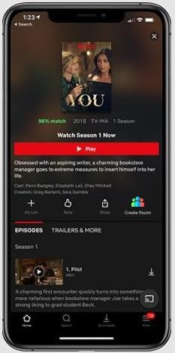
Solution 01
Netflix Theatre
Feature 01:
“Create Room” option lets the user create a room to which other Netflix subscribers can be added. The user sends a “Movie invite” to friends/family to join the room.
This invite also includes details such as movie name and start time of the movie.
The friends will get the notification to join the room if they have Netflix subscription. Else they get a referral to subscribe to Netflix in order to join the room.
After the members join the room, the start time of the movie will be displayed. Play/Pause will be synchronized for all users in the room while the movie is played. Hence the users will watch the movie at the same time.
There will be a “Chat option” available to have lively conversation on the movie with all the room members.
Insights: There are third party extensions available to facilitate Netflix screen sharing. Netflix Theatre will help to facilitate the social bonding for the Netflix users through the platform. Hence this will also help in acquisition of more users.
User Value Proposition: This feature will help in increasing the user engagement by leveraging the social interaction with their close ones.
Success Metrics:
No. of rooms created in a month
No. of movie invites sent by a user
No. of users joined a room
Time spent by users in a room

Slide 5
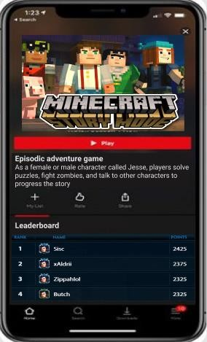
Solution 02
Netflix Games
Feature 02:
A new category “Netflix Games” will be added.
Popular games will be displayed similar to the movies tile. It will have multiplayer games to foster social interaction that helps in acquiring more users.
Game Trailers will be displayed for the user to get a preview of the games before the user starts the game.
Leaderboard lists the users based on scores earned through games. Goodies given to the Netflix Star players.
Insights: Provide wider variety of entertainment for a larger audience. This requires onboarding the cloud game developers/providers into the platform.
User Value Proposition: Entertainment through intellectual stimulation and a platform to socialize with friends.
Success Metrics:
MAU/DAU on games
Duration of active game sessions
No. of players in a game
Time spent by user in a game
“Gaming is the most expansive category in the entertainment industry, as people everywhere turn to gaming to connect, socialize and play with their friends,”
says Satya Nadella, Microsoft CEO

Slide 6
Netflix Live Stream
Netflix Preview
Feature 03:
Live Stream: In the Netflix home page, live stream can be shown as stories on the top.
It could be livestream or short videos of current events. The events can be sports, news, concerts, etc.
This can be done in a pilot phase by tie-ups with sports channels to have live sports broadcasted on Netflix for the sports lovers.
Insight:
Providing entertainment in different forms
User Value Proposition:
Engagement with users who wants a short break from the busy schedule
Feature 04:
Preview: Users can view the trailers in the home page before subscribing to the platform.
The user can view 30 minutes of the first episode of the popular 3 shows.
Insight:
Free glimpse of the show can instill curiosity to watch further
User Value Proposition:
User gets an idea of what they are subscribing for
Success Metrics:
Average no. of user views for a livestream
No. of livestream views by a user
View rate
Time spent by a user on a livestream
Success Metrics:
No. of new subscriptions
View rate
User session duration

Slide 7
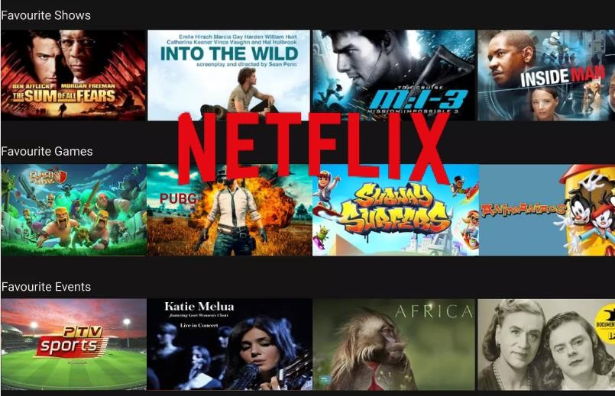

By Naafiah Sadique published December 16, 2020
OTT | Entertainment Industry | Business
PM School Blog
Netflixplans todominate entertainmentindustry
Netflix, the OTT content platform and production company is venturing into other segments of entertainment industry including the gaming and live streaming. This move is inline with its mission to entertain the world.
The company is all set to launch its Netflix theatre to provide the users the opportunity to watch shows with their dear and near ones. The platform lets the user create room to enable live conversation.
Netflix is venturing into other forms of entertainment and launching a new Netflix Games category to remove user boredom and allows more engagement. Not just that, there is a Live Stream of current events and happenings. Netflix is making a major makeover with Netflix Preview by enabling the new users to get a glimpse of the platform before subscribing to it. The OTT platform is all set to entertain the whole world in different forms and be the leader in the entire entertainment industry.

Slide 8

Thank You
See What’s Next

